Slide 1
Linux device driver
Day 8 PPT
-SUBITHRA s

Slide 2
Insertion sort
Initialization:
Start with the second element of the array.
Comparisons:
Compare each element with the sorted subarray to its left.
Shifting:
If the element is smaller, shift the larger elements one position to the right to make space for the new element.
Insertion:
Insert the element in its correct position in the sorted subarray.
Key steps:
Iterate over each element starting from the second one.
Store the current element in a variable (key).
Compare the key with elements in the sorted subarray to its left.
Shift larger elements one position to the right until finding the correct position for the key.
Insert the key into its correct position in the sorted subarray.

Slide 3
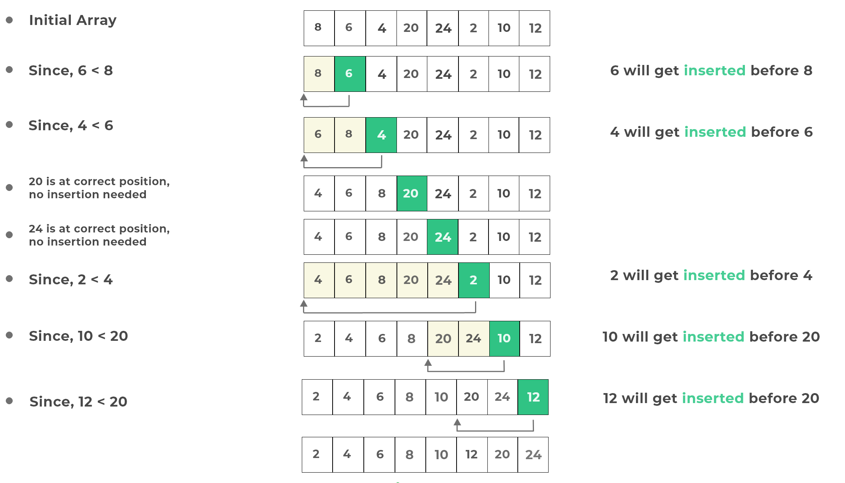
Insertion sort

Slide 4
Bubble sort
Initialization:
Start from the beginning of the array.
Comparison and swapping:
Compare adjacent elements in the array.
If the current element is greater than the next element, swap them.
Iteration:
Repeat the comparison and swapping process until the end of the array is reached.
Optimization:
After each iteration, the largest unsorted element "bubbles up" to its correct position.
The sorted portion of the array grows with each iteration, reducing the size of the unsorted portion.
Completion:
Continue iterating until no more swaps are needed, indicating that the array is sorted.

Slide 5
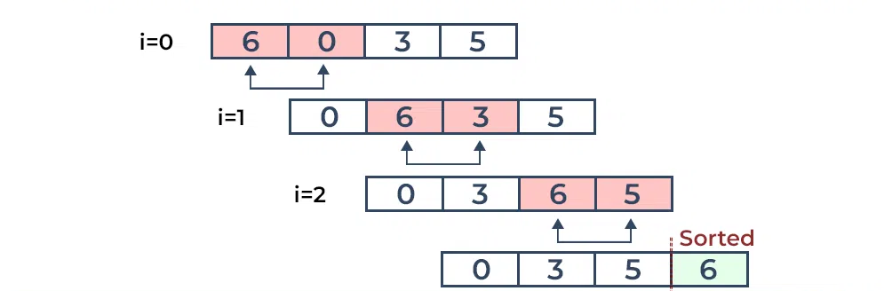
Bubble sort

Slide 6
Quick sort
Partitioning:
Choose a pivot element from the array.
Rearrange the elements in the array so that all elements less than the pivot come before it, and all elements greater than the pivot come after it.
Recursion:
Recursively apply quick sort to the subarrays formed by the partitioning process.
Each subarray is sorted independently using the same procedure.
Base case:
Terminate the recursion when the subarray size becomes 1 or 0, as such arrays are inherently sorted.
Combining:
Combine the sorted subarrays to obtain the final sorted array.

Slide 7
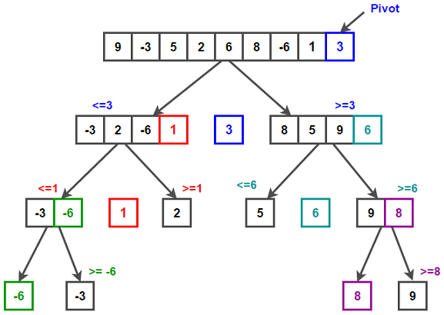
Quick sort

Slide 8
Merge sort
Divide:
Divide the unsorted array into two halves recursively until each subarray contains only one element.
Conquer:
Merge the smaller sorted arrays back together in a sorted manner.
Merge:
Compare elements from both subarrays and place them in sorted order into a temporary array.
Continue this process until all elements are merged into a single sorted array.
Repeat:
Repeat the divide-and-conquer process recursively until the entire array is sorted.
Base case:
Terminate the recursion when a subarray contains only one element, as a single element is inherently sorted.

Slide 9
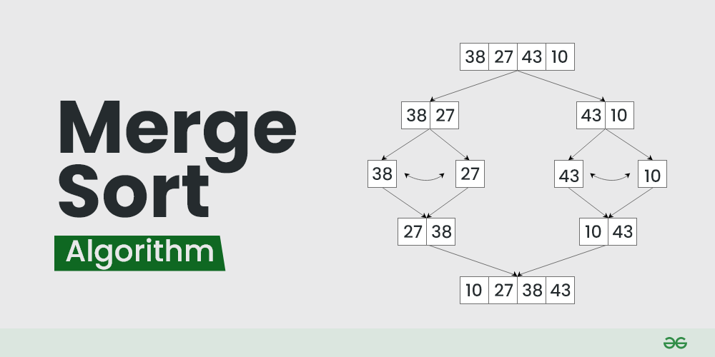
Merge sort

Slide 10
THANK YOU

